Slide 1
Soil analysis using machine learning
By: Mahmood Yousaf
Supervisor: Dr. Malik Jahan Khan

Slide 2
Agenda
Problem statement
Proposed solution
Dataset
Methodology
Results
Deployment
Soil NPK sensor
Questions

Slide 3




Problem statement
Time consuming
Soil sample
Laboratory testing
More cost

Slide 4

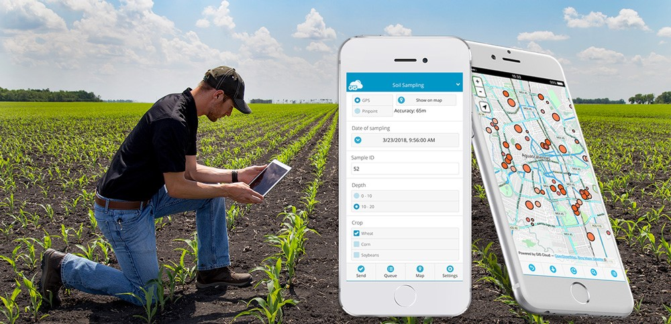

Solution
Provide Report
Fertilizer recommendations
Mobile Application
Soil Sampling
AI models

Slide 5
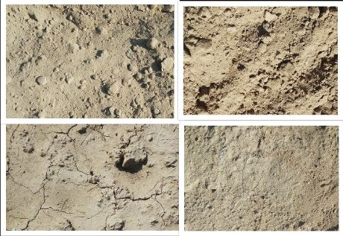
Namal Soil Lab Dataset
Collected Samples
Testing Details
Collected Images
District | Samples
Attock | 133
Chakwal | 314
Mianwali | 896
Khusab | 981
Collected Samples | 2324
District | Status
Attock | Remaining
Chakwal | Testing Done
Mianwali | Testing Done
Khusab | Ongoing
Tested Samples | 970

Slide 6
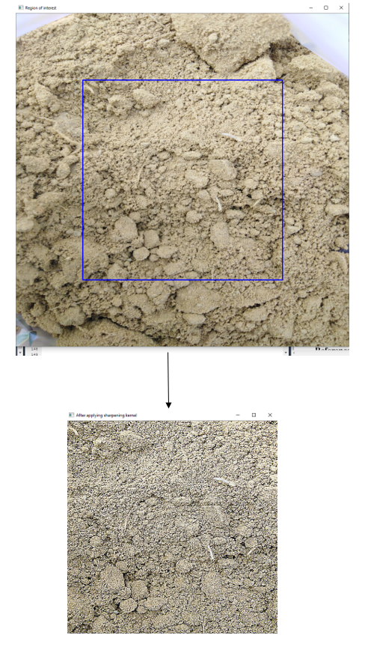
Preprocessing
Image resizing using OpenCV
Extracted ROI
Applying sharpening kernel
Sharpening kernel for dealing with blur effect and some lightening issues
Fig: Extracting ROI and applying sharpening kernel

Slide 7
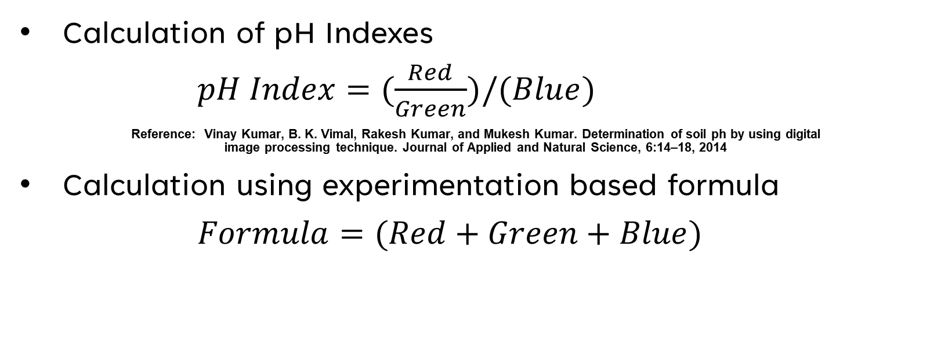
Features extraction
Calculation of pH Indexes
$pH Index=(\frac{Red}{Green})/(Blue)$
Reference: Vinay Kumar, B. K. Vimal, Rakesh Kumar, and Mukesh Kumar. Determination of soil ph by using digital image processing technique. Journal of Applied and Natural Science, 6:14–18, 2014
Calculation using experimentation based formula
$Formula=(Red+Green+Blue)$

Slide 8
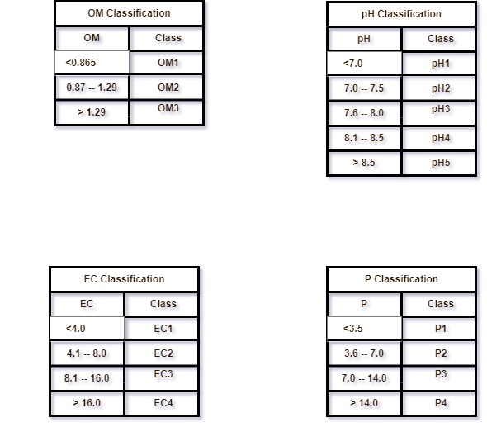
Discretization
By using soil laboratory manual

Slide 9
Libraries and tools
TensorFlow
Sklearn
Pandas
NumPy
OpenCV
Flask
Cuda
Keras

Slide 10
Methodology
Artificial neural networks (ANN) models (8)
Support Vector Regression (SVR) models (8)
Decision Tree Regression (DTR) models (8)
Random Forest Regression (RFR) models (8)
Convolution neural network (CNN) regression models (4)
Convolution neural network (CNN) classification models (4)
Total models are 40
Each model is trained for each parameter separately

Slide 11
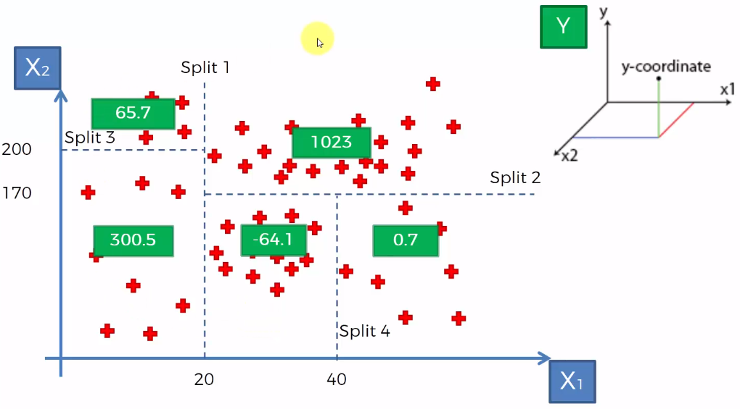
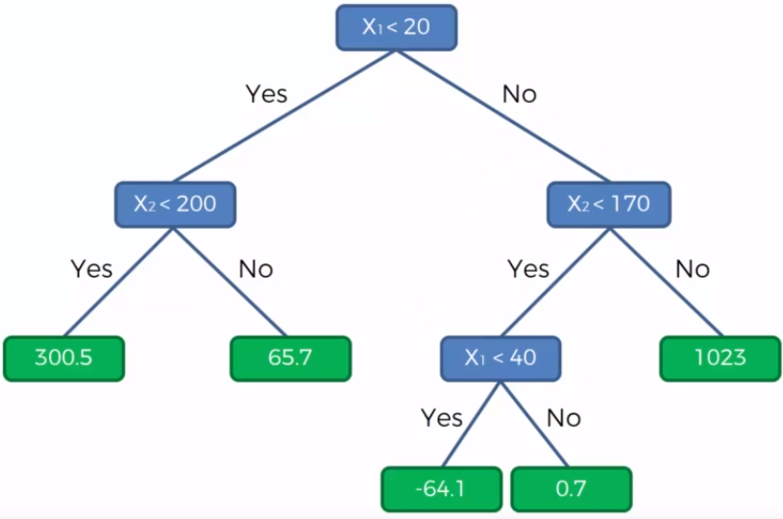
Decision tree regression
Supervised learning algorithm
Fig1: Dataset splits
Fig2: Decision tree

Slide 12
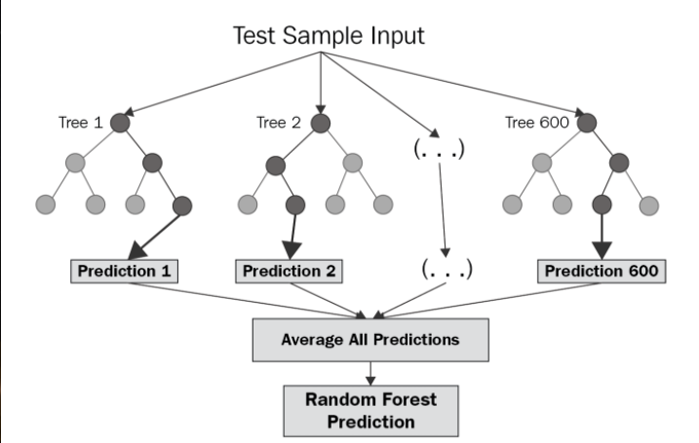
Random forest regression tree
Supervised learning algorithm
Fig1: Random forest regression tree

Slide 13
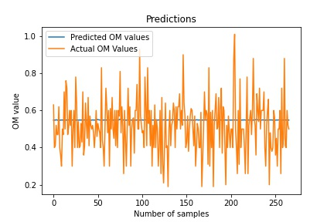
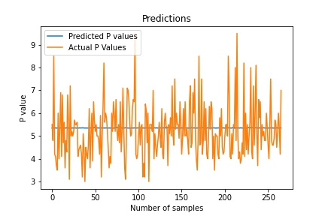
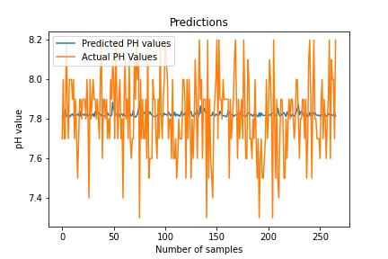
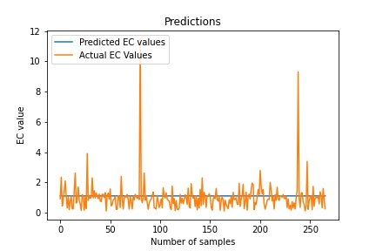
ANN Regression Models Visualizations on pH Indexes

Slide 14
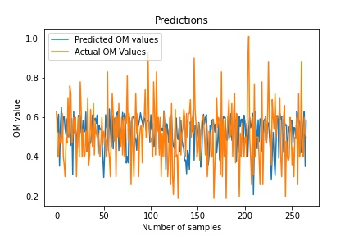
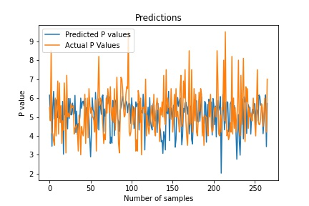
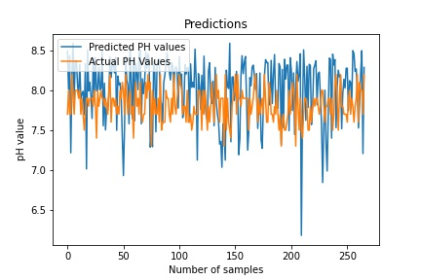
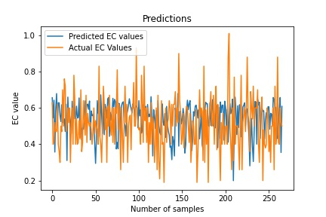
ANN Regression Models Visualizations on Formula

Slide 15
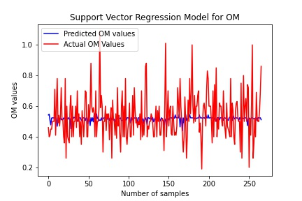
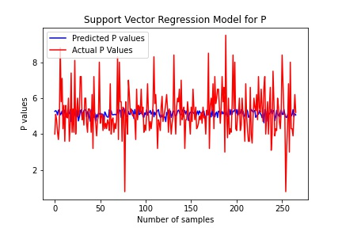
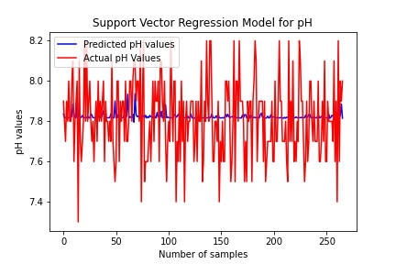
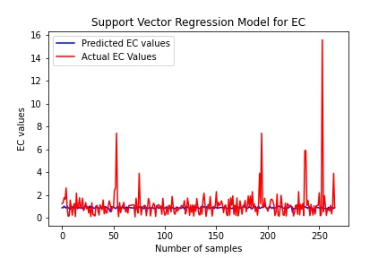
SVR Regression Models Visualizations on pH Indexes
1/27/2022

Slide 16
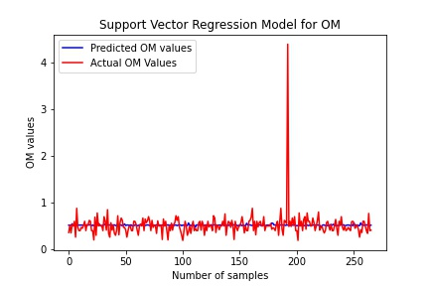
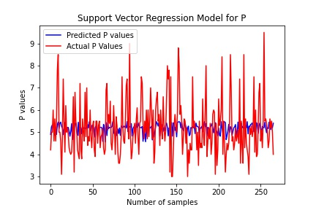
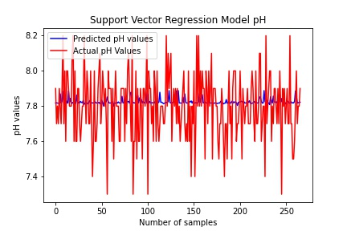
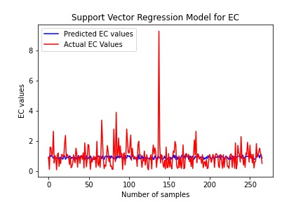
SVR Regression Models Visualizations on Formula

Slide 17
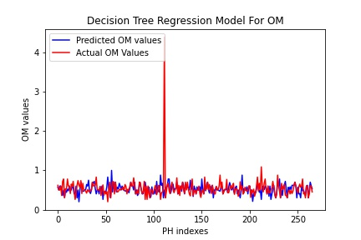
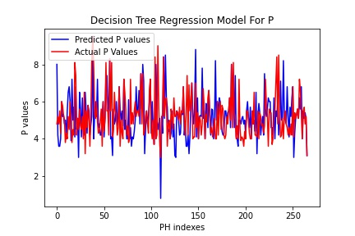
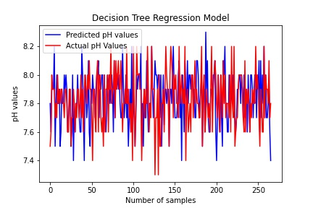
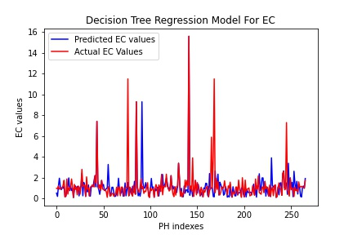
DTR Regression Models Visualizations on pH Indexes
Number of samples
Number of samples
Number of samples

Slide 18
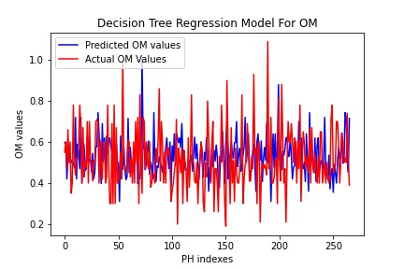
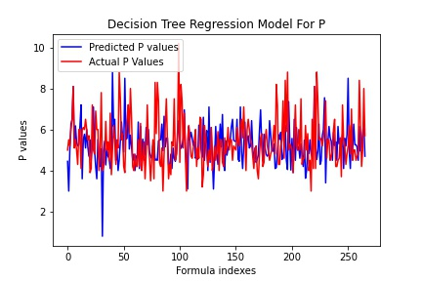
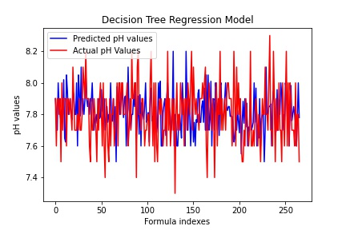
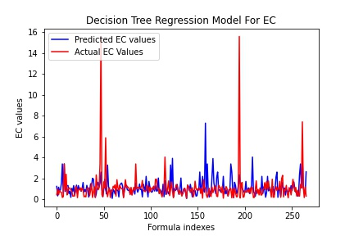
DTR Regression Models Visualizations on Formula
Number of samples
Number of samples
Number of samples
Number of samples

Slide 19
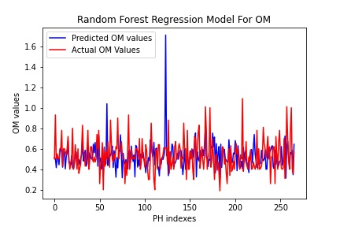
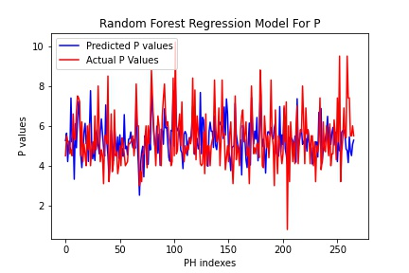
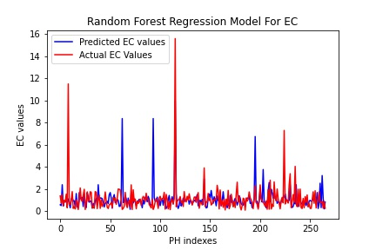
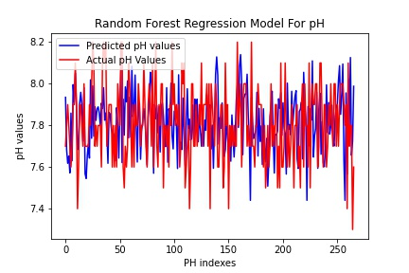
RFR Regression Models Visualizations on pH Indexes
Number of samples
Number of samples
Number of samples
Number of samples

Slide 20
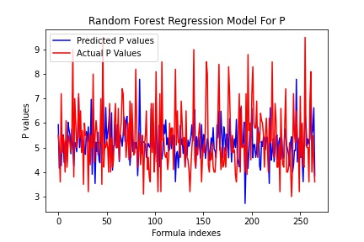
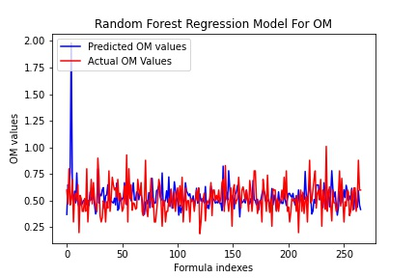
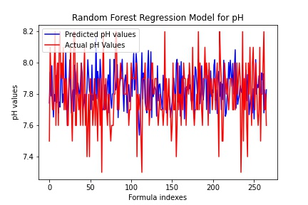
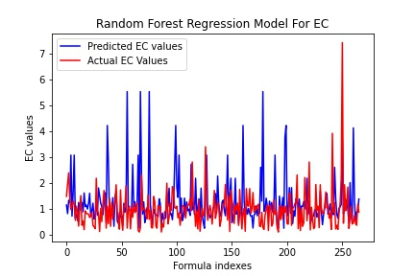
RFR Regression Models Visualizations on Formula
Number of samples
Number of samples
Number of samples
Number of samples

Slide 21
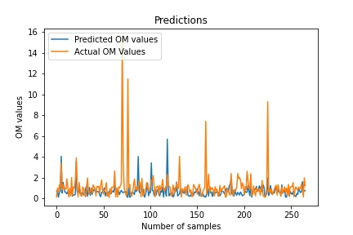
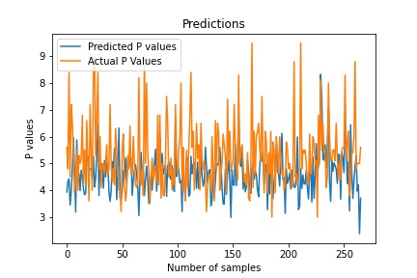
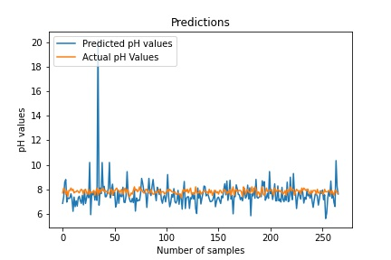
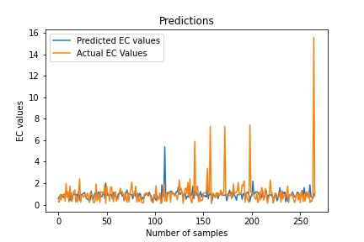
CNN Regression Models Visualizations

Slide 22
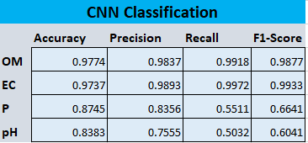
CNN Classification Models Evaluations
Fig: OM, EC, P and pH evaluations scores on CNN

Slide 23
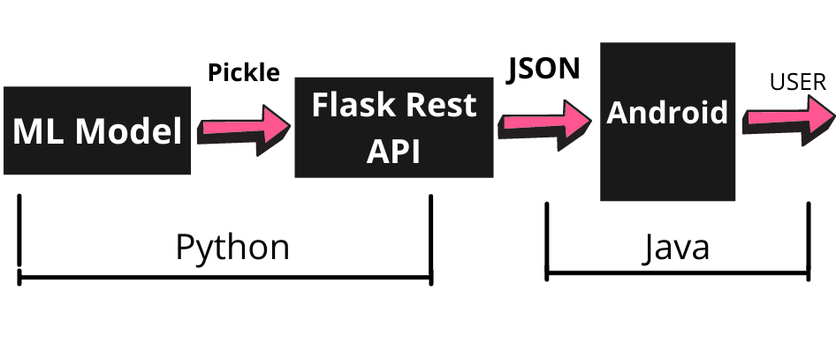
Models deployment

Slide 24
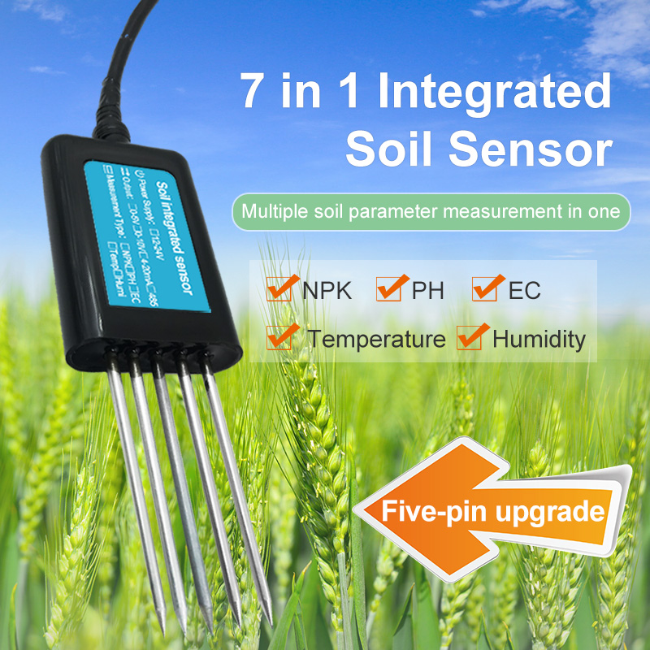
Soil NPK sensor
Soil NPK sensor ( 7 in 1)

Slide 25
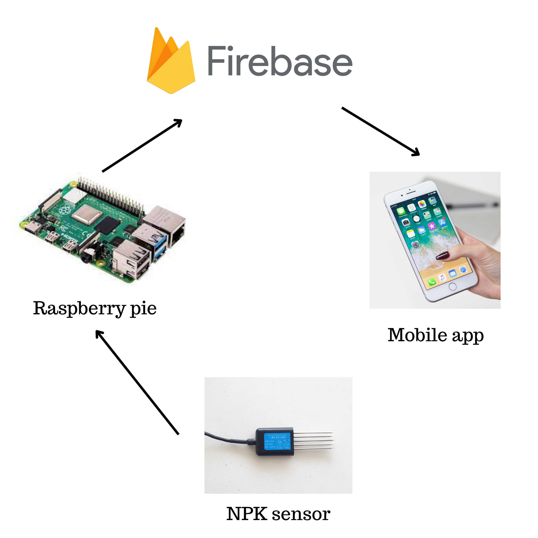
Sensor integration with mobile application

Slide 26
Demo ☺

Slide 27
Questions ☺

Slide 28
References
2022 Cost of Soil Testing | Price of Soil Quality Testing and Analysis – HomeAdvisor
Soil sampling using mobile - Google Search
Vinay Kumar, B. K. Vimal, Rakesh Kumar, and Mukesh Kumar. Determination of soil ph by using digital image processing technique. Journal of Applied and Natural Science, 6:14–18, 2014.
CS ManikandaBabu and M Arun Pandian. Determination of physical and chemical characteristics of soil using digital image processing. DIGITAL IMAGE PROCESSING, 1:2, 2016.
AV Guilalas, M Devoor, M Mizoguchi International Journal of . . . , and 2019. Determination of soil ph using digital image processing. 2019
Final-Year-Project-Soil-Analysis-using-machine-learning/Soil Lab manual.pdf at master · yousaf2018/Final-Year-Project-Soil-Analysis-using-machine-learning (github.com)
heroku ml deployment on mobile application - Google Search
Part 1: Introduction - How Smart Agriculture is Leveraging IoT! - The Techpages

